Slide 1
ICML 2001
Conditional Random Fields:
Probabilistic Models for Segmenting and Labeling Sequence Data
John Lafferty, Andrew McCallum, Fernando Pereira
Presentation by Rongkun Shen
Nov. 20, 2003

Slide 2
Sequence Segmenting and Labeling
Goal: mark up sequences with content tags
Application in computational biology
  DNA and protein sequence alignment
  Sequence homolog searching in databases
  Protein secondary structure prediction
  RNA secondary structure analysis
Application in computational linguistics & computer science
  Text and speech processing, including topic segmentation, part-of-speech (POS) tagging
  Information extraction
  Syntactic disambiguation

Slide 3
Example: Protein secondary structure prediction
Conf: 977621015677468999723631357600330223342057899861488356412238
Pred: CCCCCCCCCCCCCEEEEEEECCCCCCCCCCCCCHHHHHHHHHHHHHHHCCCCEEEEHHCC
AA: EKKSINECDLKGKKVLIRVDFNVPVKNGKITNDYRIRSALPTLKKVLTEGGSCVLMSHLG
10 20 30 40 50 60
Conf: 855764222454123478985100010478999999874033445740023666631258
Pred: CCCCCCCCCCCCCCCCCCCCCCCCCCHHHHHHHHHHHHHCCCCCCCCCCCCHHHHHHCCC
AA: RPKGIPMAQAGKIRSTGGVPGFQQKATLKPVAKRLSELLLRPVTFAPDCLNAADVVSKMS
70 80 90 100 110 120
Conf: 874688611002343044310017899999875053355212244334552001322452
Pred: CCCEEEECCCHHHHHHCCCCCHHHHHHHHHHHHHCCEEEECCCCCCCCCCCCCCCCHHHH
AA: PGDVVLLENVRFYKEEGSKKAKDREAMAKILASYGDVYISDAFGTAHRDSATMTGIPKIL
130 140 150 160 170 180

Slide 4
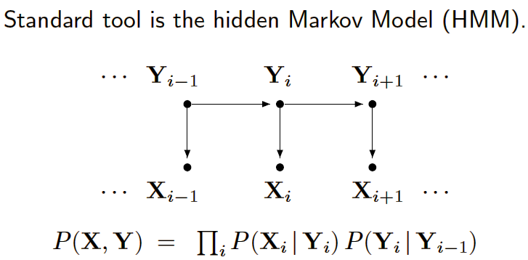
Generative Models
Hidden Markov models (HMMs) and stochastic grammars
  Assign a joint probability to paired observation and label sequences
  The parameters typically trained to maximize the joint likelihood of train examples

Slide 5
Generative Models (cont’d)
Difficulties and disadvantages
  Need to enumerate all possible observation sequences
  Not practical to represent multiple interacting features or long-range dependencies of the observations
  Very strict independence assumptions on the observations

Slide 6
Conditional Models
Conditional probability P(label sequence y | observation sequence x) rather than joint probability P(y, x)
  Specify the probability of possible label sequences given an observation sequence
Allow arbitrary, non-independent features on the observation sequence X
The probability of a transition between labels may depend on past and future observations
  Relax strong independence assumptions in generative models

Slide 7
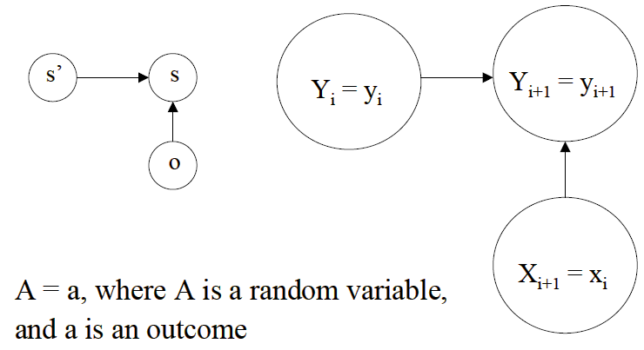
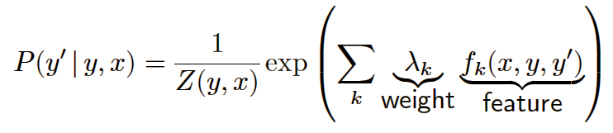
Discriminative Models
Maximum Entropy Markov Models (MEMMs)
Exponential model
Given training set X with label sequence Y:
  Train a model θ that maximizes P(Y|X, θ)
  For a new data sequence x, the predicted label y maximizes P(y|x, θ)
  Notice the per-state normalization

Slide 8
MEMMs (cont’d)
MEMMs have all the advantages of Conditional Models
Per-state normalization: all the mass that arrives at a state must be distributed among the possible successor states (“conservation of score mass”)
Subject to Label Bias Problem
  Bias toward states with fewer outgoing transitions

Slide 9
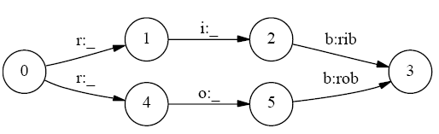
Label Bias Problem
Consider this MEMM:
P(1 and 2 | ro) = P(2 | 1 and ro)P(1 | ro) = P(2 | 1 and o)P(1 | r)
P(1 and 2 | ri) = P(2 | 1 and ri)P(1 | ri) = P(2 | 1 and i)P(1 | r)
Since P(2 | 1 and x) = 1 for all x, P(1 and 2 | ro) = P(1 and 2 | ri)
In the training data, label value 2 is the only label value observed after label value 1
Therefore P(2 | 1) = 1, so P(2 | 1 and x) = 1 for all x
However, we expect P(1 and 2 | ri) to be greater than P(1 and 2 | ro).
Per-state normalization does not allow the required expectation

Slide 10
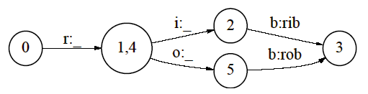
Solve the Label Bias Problem
Change the state-transition structure of the model
  Not always practical to change the set of states
Start with a fully-connected model and let the training procedure figure out a good structure
  Prelude the use of prior, which is very valuable (e.g. in information extraction)

Slide 11
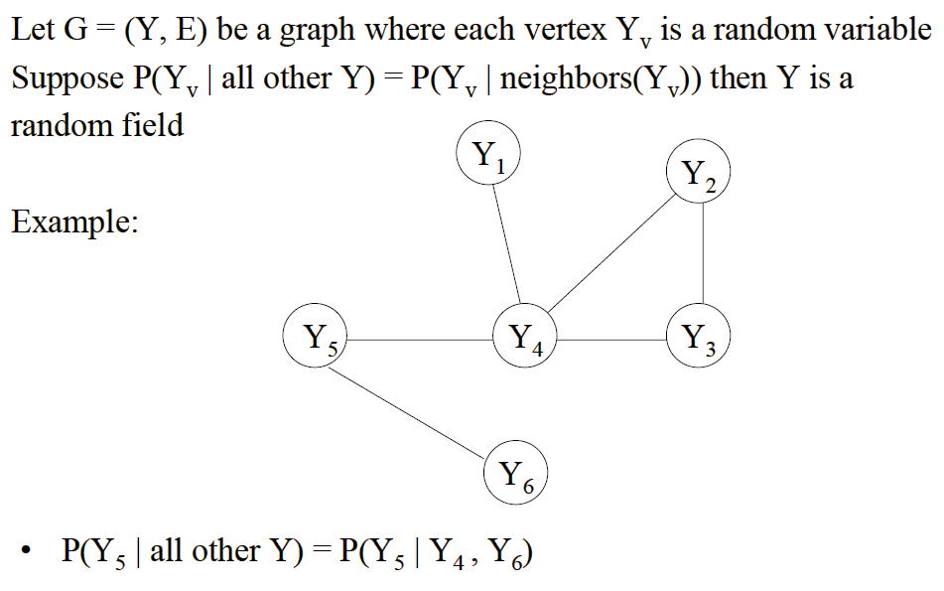
Random Field

Slide 12
Conditional Random Fields (CRFs)
CRFs have all the advantages of MEMMs without label bias problem
  MEMM uses per-state exponential model for the conditional probabilities of next states given the current state
  CRF has a single exponential model for the joint probability of the entire sequence of labels given the observation sequence
Undirected acyclic graph
Allow some transitions “vote” more strongly than others depending on the corresponding observations

Slide 13
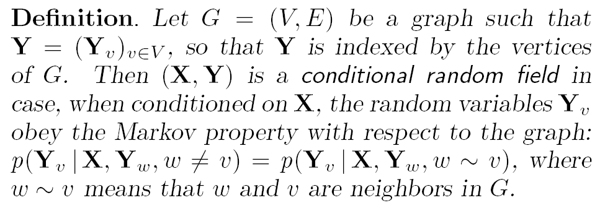
Definition of CRFs
X is a random variable over data sequences to be labeled
Y is a random variable over corresponding label sequences

Slide 14
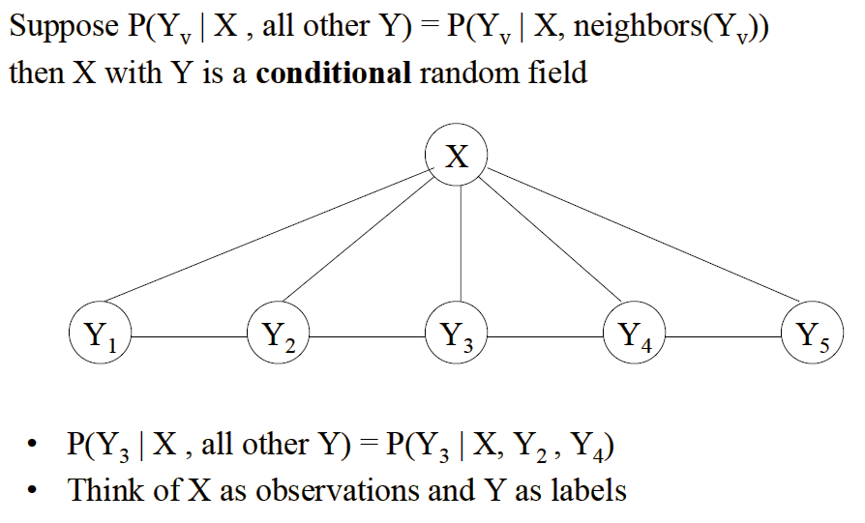
Example of CRFs

Slide 15
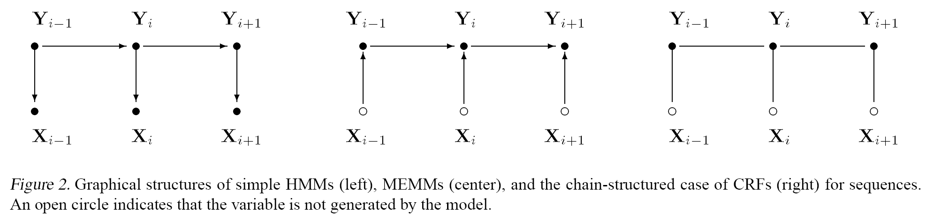
Graphical comparison among
HMMs, MEMMs and CRFs
HMM MEMM CRF

Slide 16
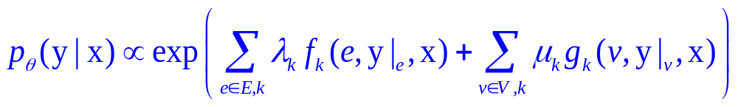
Conditional Distribution
If the graph G = (V, E) of Y is a tree, the conditional distribution over the label sequence Y = y, given X = x, by fundamental theorem of random fields is:
x is a data sequence
y is a label sequence
v is a vertex from vertex set V = set of label random variables
e is an edge from edge set E over V
f_{k} and g_{k} are given and fixed. g_{k} is a Boolean vertex feature; f_{k} is a Boolean edge feature
k is the number of features
are parameters to be estimated
y|_{e} is the set of components of y defined by edge e
y|_{v} is the set of components of y defined by vertex v

Slide 17
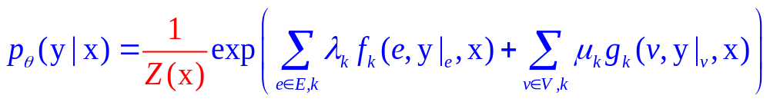
Conditional Distribution (cont’d)
CRFs use the observation-dependent normalization Z(x) for the conditional distributions:
Z(x) is a normalization over the data sequence x

Slide 18
Parameter Estimation for CRFs
The paper provided iterative scaling algorithms
It turns out to be very inefficient
Prof. Dietterich’s group applied Gradient Descendent Algorithm, which is quite efficient

Slide 19
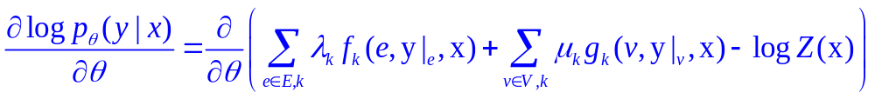

Training of CRFs (From Prof. Dietterich)
First, we take the log of the equation
Then, take the derivative of the above equation
For training, the first 2 items are easy to get.
For example, for each λ_{k}, f_{k} is a sequence of Boolean numbers, such as 00101110100111.
      is just the total number of 1’s in the sequence.
The hardest thing is how to calculate Z(x)

Slide 20
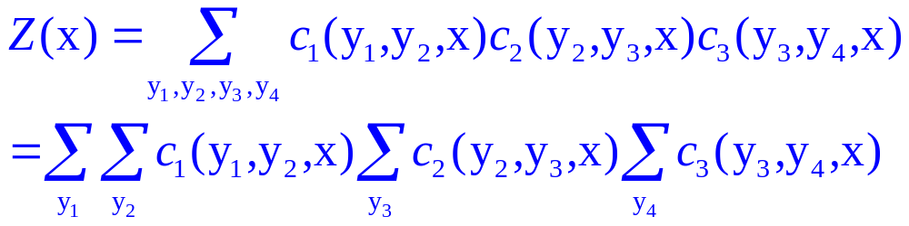
Training of CRFs (From Prof. Dietterich) (cont’d)
Maximal cliques
y₁
y₂
y₃
y₄
c₁
c₂
c₃
c₁
c₂
c₃

Slide 21
Modeling the label bias problem
In a simple HMM, each state generates its designated symbol with probability 29/32 and the other symbols with probability 1/32
Train MEMM and CRF with the same topologies
A run consists of 2,000 training examples and 500 test examples, trained to convergence using Iterative Scaling algorithm
CRF error is 4.6%, and MEMM error is 42%
MEMM fails to discriminate between the two branches
CRF solves label bias problem

Slide 22
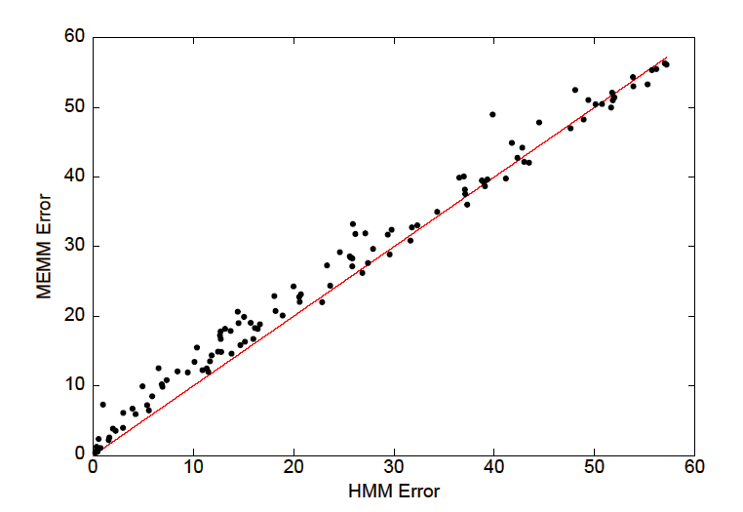
MEMM vs. HMM
The HMM outperforms the MEMM

Slide 23
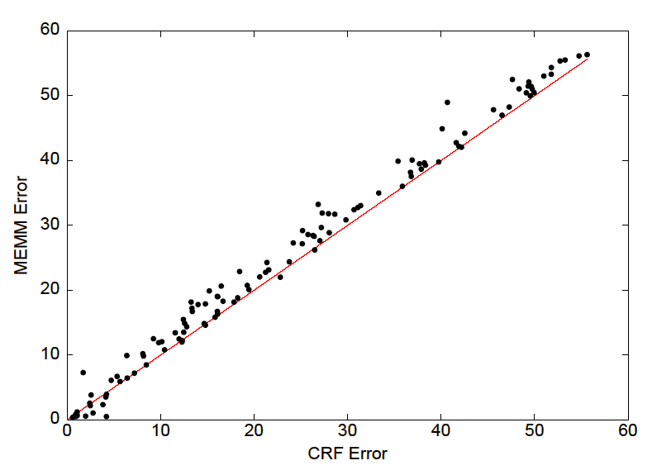
MEMM vs. CRF
CRF usually outperforms the MEMM

Slide 24
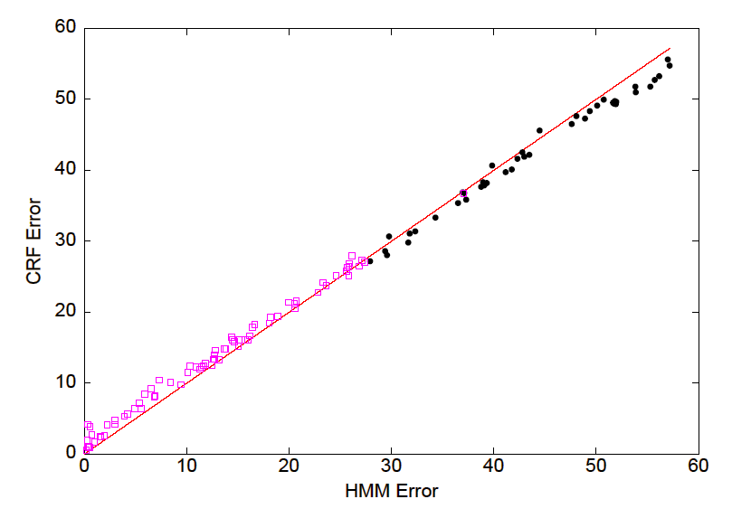
CRF vs. HMM
Each open square represents a data set with α < 1/2, and a solid circle indicates
a data set with α ≥ 1/2; When the data is mostly second order (α ≥ 1/2), the
discriminatively trained CRF usually outperforms the HMM

Slide 25
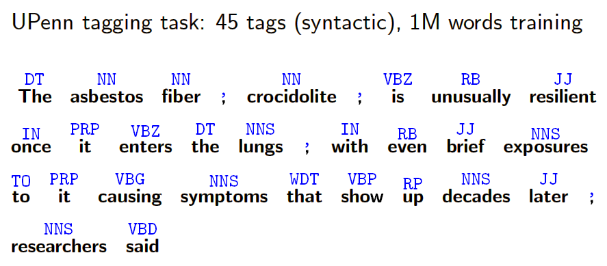
POS tagging Experiments

Slide 26
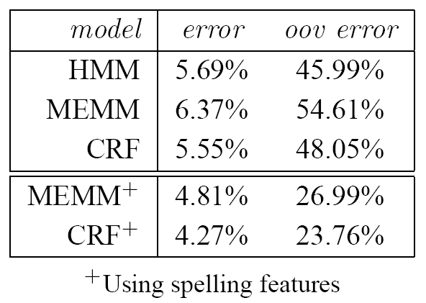
POS tagging Experiments (cont’d)
Compared HMMs, MEMMs, and CRFs on Penn treebank POS tagging
Each word in a given input sentence must be labeled with one of 45 syntactic tags
Add a small set of orthographic features: whether a spelling begins with a number or upper case letter, whether it contains a hyphen, and if it contains one of the following suffixes: -ing, -ogy, -ed, -s, -ly, -ion, -tion, -ity, -ies
oov = out-of-vocabulary (not observed in the training set)

Slide 27
Summary
Discriminative models are prone to the label bias problem
CRFs provide the benefits of discriminative models
CRFs solve the label bias problem well, and demonstrate good performance

Slide 28
Thanks for your attention!
Special thanks to
Prof. Dietterich & Tadepalli!

